Slide 1
FinTech & Digital-First Financial Services
AI orchestration for FinTechs, digital lenders, payments platforms & embedded finance — powered by the #1 iPaaS
Notes:
Slide Structure:
Slide 1: Title + Hook
Title: "Accelerating Banking Operations with AI & Automation"
Subtitle: [Prospect Bank Name] + Workato
Visual: Banking imagery (not stock handshake clichés)
Script: "Thanks for the time today. I want to share how leading banks are using automation to transform loan processing, compliance, and customer experience..."
Slide 2: The Challenge (Industry-Specific)
Headline: "Banks Are Caught Between Growth Pressure and Operational Complexity"
Content (3 visual stats):
📉 "Customer expectations: Same-day loan decisions"
⚠️ "Reality: 7-14 day processing times, 23% abandonment"
💰 "Impact: $4.2M in lost revenue annually for mid-size banks"
Visual: Icons + brief stats (not bullet points)
Script: "What we're hearing from banks like yours: customers expect instant decisions, but manual processes across Salesforce, your LOS, and core banking create bottlenecks..."
Slide 3: The Workato Approach (Solution Framework)
Headline: "Orchestrate Data, Systems & AI Across Your Banking Operations"
Content (3 capability pillars with icons):
🔗 Connect Everything: 1200+ connectors (Salesforce, nCino, Temenos, SAGE, Guidewire)
🤖 Add Intelligence: AI agents for underwriting, fraud checks, compliance
⚡ Empower Teams: Business users build workflows, not just IT
Visual: Simple architecture diagram showing systems flowing through Workato
Script: "Workato sits in the middle, orchestrating data between your CRM, loan origination, core banking, and compliance systems. Your business teams can build and modify these workflows without waiting on IT..."
Slide 4: Proof (Customer Success Snapshot)
Headline: "[Similar Bank/Credit Union] Achieved These Results in 6 Months"
Content (Before/After metrics):
Loan processing: 7 days → 4 hours ⚡
Cost per loan: $450 → $180 💰
Compliance violations: 12 → 0 ✅
FTE redeployed: 15 employees to customer service 👥
Visual: Customer logo + headshot + quote (if approved)
Quote: "Workato gave us the agility to launch new products without rip-and-replace." - VP Digital Banking
Script: "Here's a credit union similar to you in size and tech stack. They were struggling with the same loan processing bottleneck. After implementing Workato..."
Slide 5: Next Steps (Clear CTA)
Headline: "Let's Explore What's Possible for [Prospect Name]"
Content:
✓ Discovery Workshop (2 hours): Map your loan origination process
✓ Value Assessment (1 week): Quantify your automation opportunity
✓ Pilot Use Case (30 days): Prove ROI with one workflow
Visual: Simple timeline graphic
CTA: "Can we schedule a 2-hour workshop with your lending and IT teams?"
Script: "I'd love to do a deeper dive on your specific environment. We typically start with a discovery workshop where we map your current loan process, identify automation opportunities, and build a business case..."
Customization Zones for Partners/Sellers:
Slide 1: Add partner logo (if GSI co-sell)
Slide 2: Swap industry stats (use different challenge if prospect cares more about compliance than loans)
Slide 4: Change customer proof to closest match (community bank vs. regional bank vs. credit union)

Slide 2


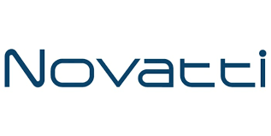

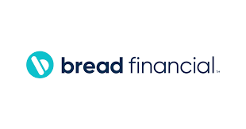

Accounts opened.
Loans approved.
Customers answered.
Work done!
Notes:
Top vertical segment messaging

Slide 3
FinTechs move fast — until the infrastructure doesn’t.
Revenue Growth: 60% of customers abandon digital onboarding if it takes more than 5 minutes. Bread Financial fixed this — 84% faster customer onboarding. First-time credit buyers don't wait. They click away to whoever onboards them faster. Enterprise Agility: Novatti reduced merchant onboarding from months to under 5 minutes — across 7 integrated systems per merchant. Backstop Solutions launched a new integration product on Workato Embed and generated 750% ROI in year one. Speed is the product. Efficiency & OrCA: Ramp reduced opportunity generation time by 97% and L1 tickets by 80%. OrCA consumption-based pricing scales with your transaction volume — no infrastructure provisioning before product launches or viral growth events. Risk Reduction: Enterprise-grade security (SOC 2 Type II, GDPR) with the speed of a low-code platform. AI agents governed by Enterprise MCP. KYC/AML automated with complete audit trail. Coinbase runs EKM + SCIM + Zero Data Logging + APIM — all on Workato.
Coinbase: $1.85M ARR.552 active recipes. 3+ business units. Largest FinServ customer by ARR. This is what FinTech scale looks like on Workato.
Notes:
Align with Value drivers of WSS.
—--------
Discover time - what are you needed to solve??

Slide 4
Built for the FinTech stack
Enterprise MCP Server Templates
Turn payment and merchant workflows into secure MCP servers. Workato Embed builds integration into your product. Cloud-native autoscaling handles any volume spike.
AI Genies
KYC Genie | CX Genie | FinAssist Genie | Support Genie | RevOps Genie | Partner Onboarding Genie
FinTech Connectors
Salesforce | HubSpot | Snowflake | Stripe | Plaid | Marqeta | Alloy | Socure | DocuSign | NetSuite | Databricks | DBT Cloud | Ironclad | Jira | Workday | PagerDuty | OpsGenie | AWS Athena | AWS Bedrock | Avalara | Anaplan
Notes:
How do we fit into the Banking ecosystem.
Connectors - Orchestration out

Slide 5
Four priorities. Proven outcomes.
Instant Customer Onboarding (KYC to Activated)
Revenue Operations & GTM Automation
Merchant & Partner Onboarding (Months to Minutes)
API Platform & Event-Driven Orchestration

Slide 6
Use Case: Instant Customer Onboarding
Current: Multi-day onboarding with manual KYC, separate identity check, and manual account provisioning. Target: KYC to activated in under 5 minutes. Bread Financial achieved 84% faster acquisition.

Slide 7
Why Workato for FinTechs & Digital-First Platforms

Slide 8
FinTechs running on Workato
Bread Financial
“With Workato, we’re able to acquire customers in minutes.” — Kristin Fretz, Director of RevOps 84% faster customer onboarding • 30 min/customer manual data entry eliminated • KYC, DocuSign, and CRM provisioning automated in one workflow
Ramp
“We transformed a 150-step Node JS process into a 25-step SQL workflow.” — Kunal Singh (NDA) 97% faster opportunity generation • 80% fewer L1 tickets • 12x faster debugging • Salesforce license optimization automated
Coinbase
Largest FinServ customer by ARR $1.85M ARR • 552 active recipes • 3+ BUs • AWS Athena + Slack + PagerDuty + Event Streams + EKM + SCIM + APIM + Workbot • Full enterprise platform orchestration — SOC 2 + EKM + Zero Data Logging active
Notes:
Links to each of the customer reference packages.

Slide 9
Bread Financial: 84% Faster Customer Onboarding
“With Workato, we’re able to acquire customers in minutes, transforming the way we expand our customer acquisition channels and grow our business.” — Kristin Fretz, Director of RevOps, Bread Financial Challenge: Manual merchant onboarding across disconnected systems. 30 min/customer manual data entry. Bottlenecks blocking sales team from growing acquisition volume. Outcomes: 84% reduction in merchant acquisition timeline • 30 min/customer manual data entry eliminated • KYC, DocuSign, and CRM provisioning automated in one workflow • Sales team reallocated from data entry to relationship management. Workato how: KYC Genie + Enterprise MCP orchestrating across Salesforce, DocuSign, and payment systems. SPEED differentiator: Fast Build + Extensive Connectivity.

Slide 10
Ramp: 97% Faster Opportunity Generation
“Through Workato, we were able to transform what was a 150-step process using Node JS into a 25-step process using SQL, leading to a significant increase in efficiency.” — Kunal Singh, Biz Systems Engineering Lead, Ramp (NDA) Challenge: Manual campaign creation errors, native Salesforce/HubSpot limitations, slow debugging. GTM team couldn’t move at business speed. Outcomes: 97% reduction in time to generate opportunities • 80% decrease in L1 support tickets • 12x faster debugging • Sales territory geo-segmentation automated • Salesforce license optimization running continuously. Workato how: RevOps automation across Salesforce, HubSpot, and Snowflake. SCALE differentiator: OrCA + Federated Model. NOTE: NDA account — confirm reference status before customer-facing use.

Slide 11
Novatti: Merchant Onboarding from Months to Under 5 Minutes
Challenge: ANZ payments FinTech onboarding new merchants required months of manual integration across 7 different systems: Sales, Risk, Legal, Support, and Payments Platform. Outcomes: 99.9% faster merchant onboarding • Months → under 5 minutes • 15 systems integrated (Pipedrive, Personr, PandaDoc, DocuSign, Jira) • $121K ARR • 167 active recipes • WFA + APIM + Zero Data Logging + Audit Streaming + Workbot all active. Workato how: Single onboarding workflow orchestrates KYC (Personr) → pricing approval → agreement (PandaDoc) → CRM (Pipedrive) → IT ticketing (Jira) → payments platform provisioning → go-live notification. POWER differentiator: Workato Embed for self-service partner integrations. Case study: workato.com/the-connector/novatti-customer-story

Slide 12



















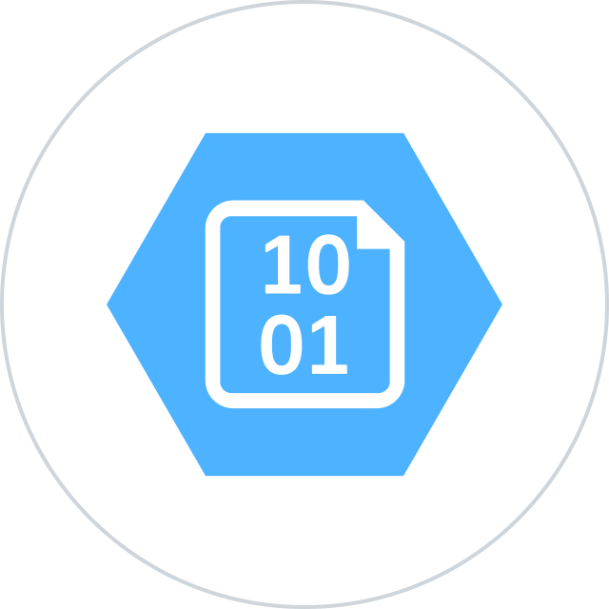


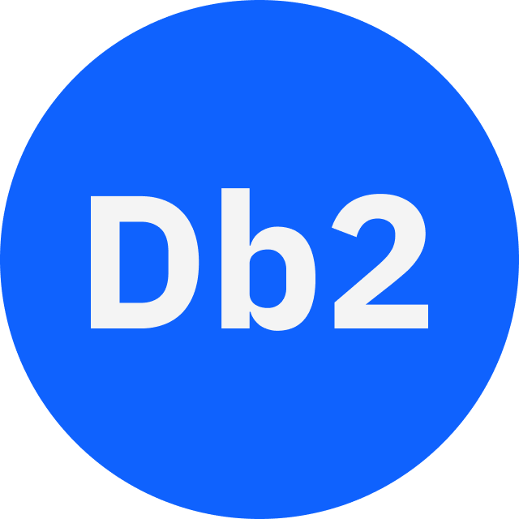




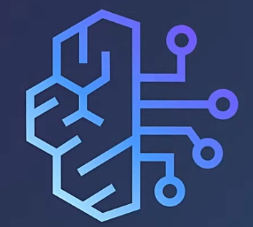
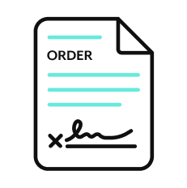







Orchestration for the Agentic Era—Powered by the #1 iPaaS.
I
Build agents with us
Go faster with Enterprise Skill packs and Workato Genies
W O R K A T O E N T E R P R I S E M C P
P L A T F O R M A G E N T S
E N T E R P R I S E S K I L L S
T R U S T
MCP Gateway
Observability
New simpler graphic
Solution Architect (AIRO™)
Skills Builder
MCP Composition
MCP Registry
MCP Proxy
Governance
O R C H E S T R A T I O N
Security
Data Scientist (Acumen)
Process Automation
Application Integration & B2B
Compliance
Data Orchestration
API Management
Explainability
Powered by iPaaS+
U N I V E R S A L C O N N E C T I V I T Y
SaaS/On-prem
Data Warehouse/ Data Lakes
Databases
LLMs
Unstructured
Traditional
Invoice
Media
Transcripts
Contracts
SFTP
Mainframe
Custom
Archives
Notes:
This is Workato ONE —Orchestration for the Agentic Era—Powered by the #1 iPaaS.
Unlike solutions that give you pieces of the puzzle, Workato ONE delivers the complete agentic enterprise:
Workato ONE One platform for data, apps, and agents
Workato GO puts enterprise search with Deep Action™ directly in every employee's hands
Workato Agentic builds and deploys production-ready agents with full enterprise context
Workato Enterprise MCP One trusted bridge for every agent to connect to applications and systems safely and securely
Workato Orchestrate powers complex workflows across teams, systems, and agents
All built on universal connectivity to 10,000+ applications and data sources
What makes this different? True Enterprise Orchestration.
Everyone talks about integration—APIs, MCP, basic workflows. But enterprise orchestration is fundamentally different. It's:
Transactionality that ensures every action completes or rolls back cleanly
In-sequence and exactly-once delivery so your financial transactions never duplicate
Runtime authentication and RBAC that enforces your security policies in real-time
PII obfuscation and data governance that maintains compliance automatically
Event-driven, batch, and real-time triggers that handle any integration pattern
Plus something no one else has: 1 million+ Enterprise Skills—pre-built, production-tested capabilities that encode your business logic, not just API calls. When an agent needs to "process a return," it doesn't just update a field—it orchestrates the entire business process across systems, with all the exception handling, approvals, and compliance checks your enterprise requires.
This unified approach enables true multi-agent orchestration. Your agents don't just connect—they inherit your enterprise's operational intelligence.

Slide 13

Thank you

Slide 14
Appendix of slides

Slide 15
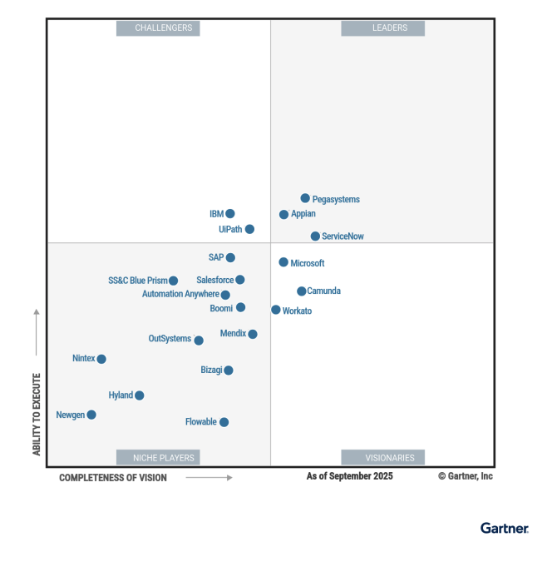
Leader in platforms and orchestration
Gartner iPaas : Leader - 7x
Visionary

